Slide 1
Health & Wellness Website
By Dalton Schnieders

Slide 2
Project Description
Problem: Professional Engineering Consultants has a health and wellness program for employees. Current data collection is done via hundreds of Excel spreadsheets that are manually collected and data compiled once a quarter.
Solution: A website that collects data from users and then presents that data in useful ways for both employees and admins

Slide 3
Requirements
Website
Sign in page
Data collection page
Data presentation page
Rewards selection
Features
Easily collect data on current progress
Display data for both users and admin in useful ways

Slide 4
Tools
Database
MySQL
Website
Javascript
NodeJS
Bootstrap
Charts
Google Visualizations

Slide 5
Data Sources
Users
Users will log their progress which will then store data into the database
Users can watch their progress as they meet goals and see how far they are from the next goal
Admins
See which users have met certain thresholds
See how many users are using the program
Can see “what works”

Slide 6
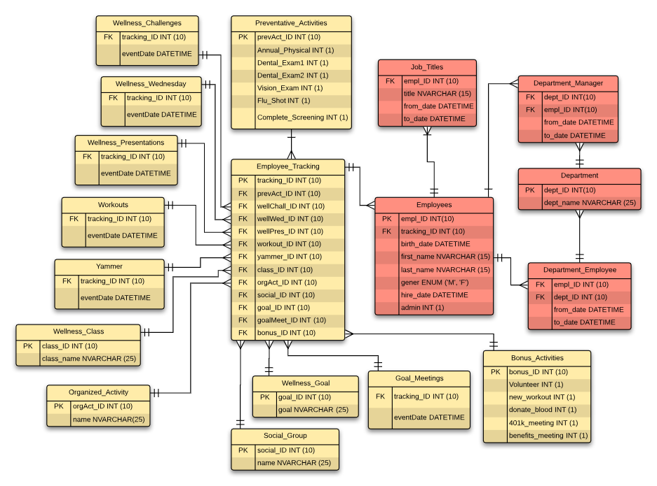
Current
DB Design

Slide 7
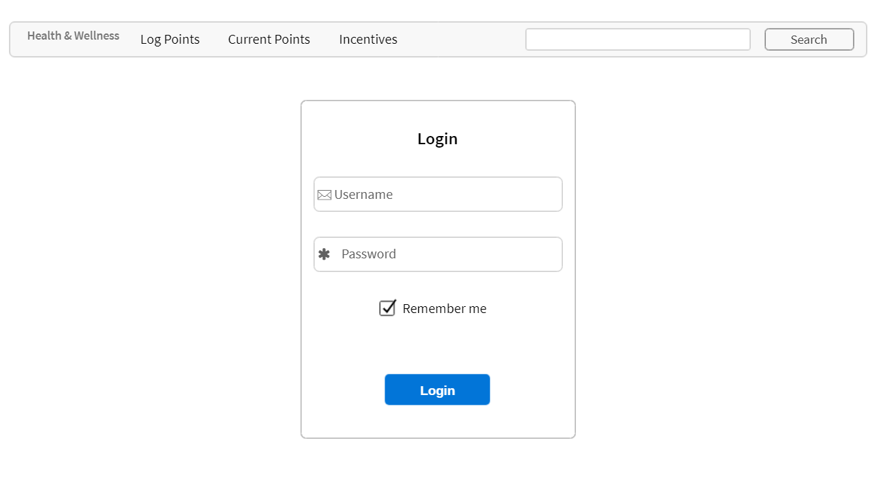
Mockup - Home

Slide 8
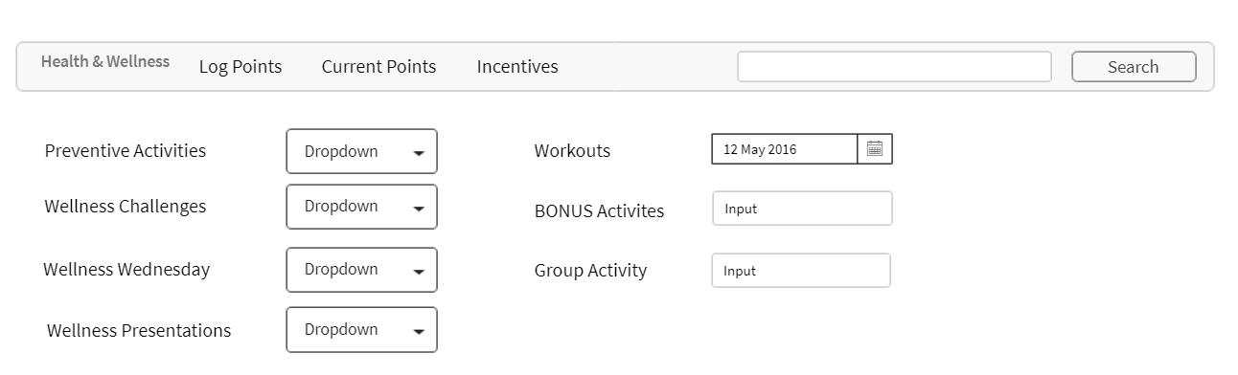
Mockup - Log Points

Slide 9
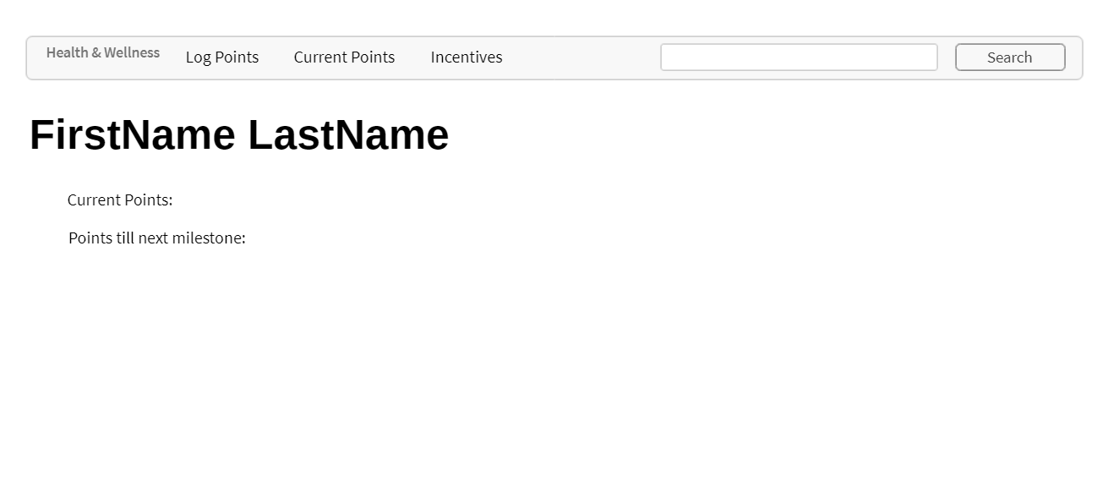
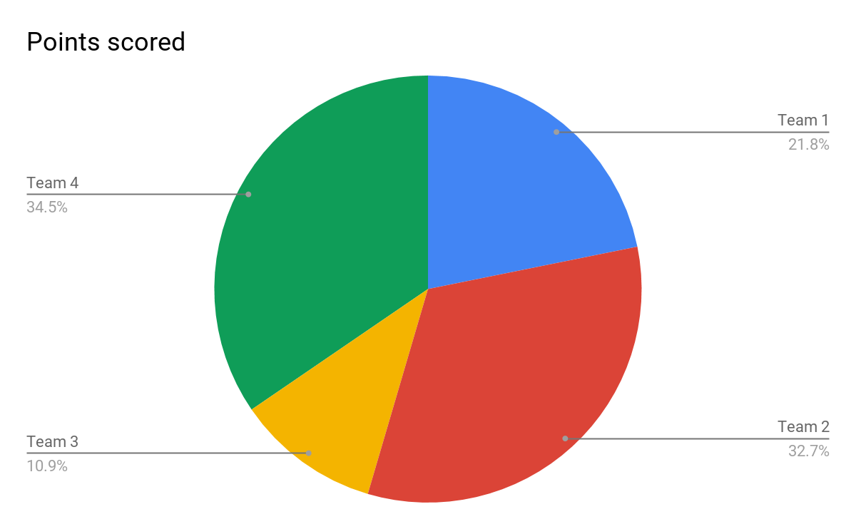
Mockup - Current Points

Slide 10
Timeline
February
Choose Project
Mockup
March
Implement Database
Implement Website
April
Test
Bug fix
Add additional features as they come up (time permitting)
May
Final Presentation

Slide 11
Questions?

